Slide 1


Slide 2







Presented by: 22AG5A0501-MENDE PUJA 21AG1A0501-ADDEPALLI PAVANTEJA 21AG1A0502-ADUNURI SURENDER 21AG1A0503-AITHAGONI AKSHITHA 21AG1A0522-GUNJI VAMSHI 21AG1A0524-KAKKERA VENKAT SAI 21AG1A0525-KALAGOTLA SUHAS 21AG1A0520-GANAGANI SAI RITHVIK GOUD 21AG1A0521-GUGULOTH LOHITHA

Slide 3
Table of Contents
02
Regression &
Data Set
Here the logistics regression and data will be presented
01
Introduction
Gives the glance of breast cancer and prediction by regression model
03
Correlation matrix
A correlation matrix is a table that shows correlation coefficients between many variables.
04
Key Accomplishments
Goals, objective and the conclusion are ended here

Slide 4
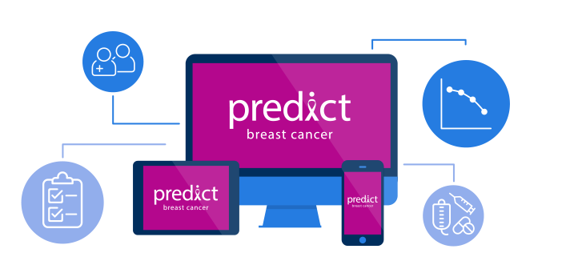
Introduction:
Breast cancer is a prevalent health concern affecting millions of individuals globally. Early detection plays a pivotal role in improving treatment outcomes and reducing mortality rates. In the realm of predictive analytics, logistic regression emerges as a valuable tool for assessing the likelihood of breast cancer occurrence based on various contributing factors.
Logistic regression is a statistical method employed in machine learning for binary classification tasks, making it well-suited for predicting the presence or absence of breast cancer. Unlike linear regression, logistic regression models the probability of an event occurring, providing a clear understanding of the relationship between input features and the binary outcome.

Slide 5
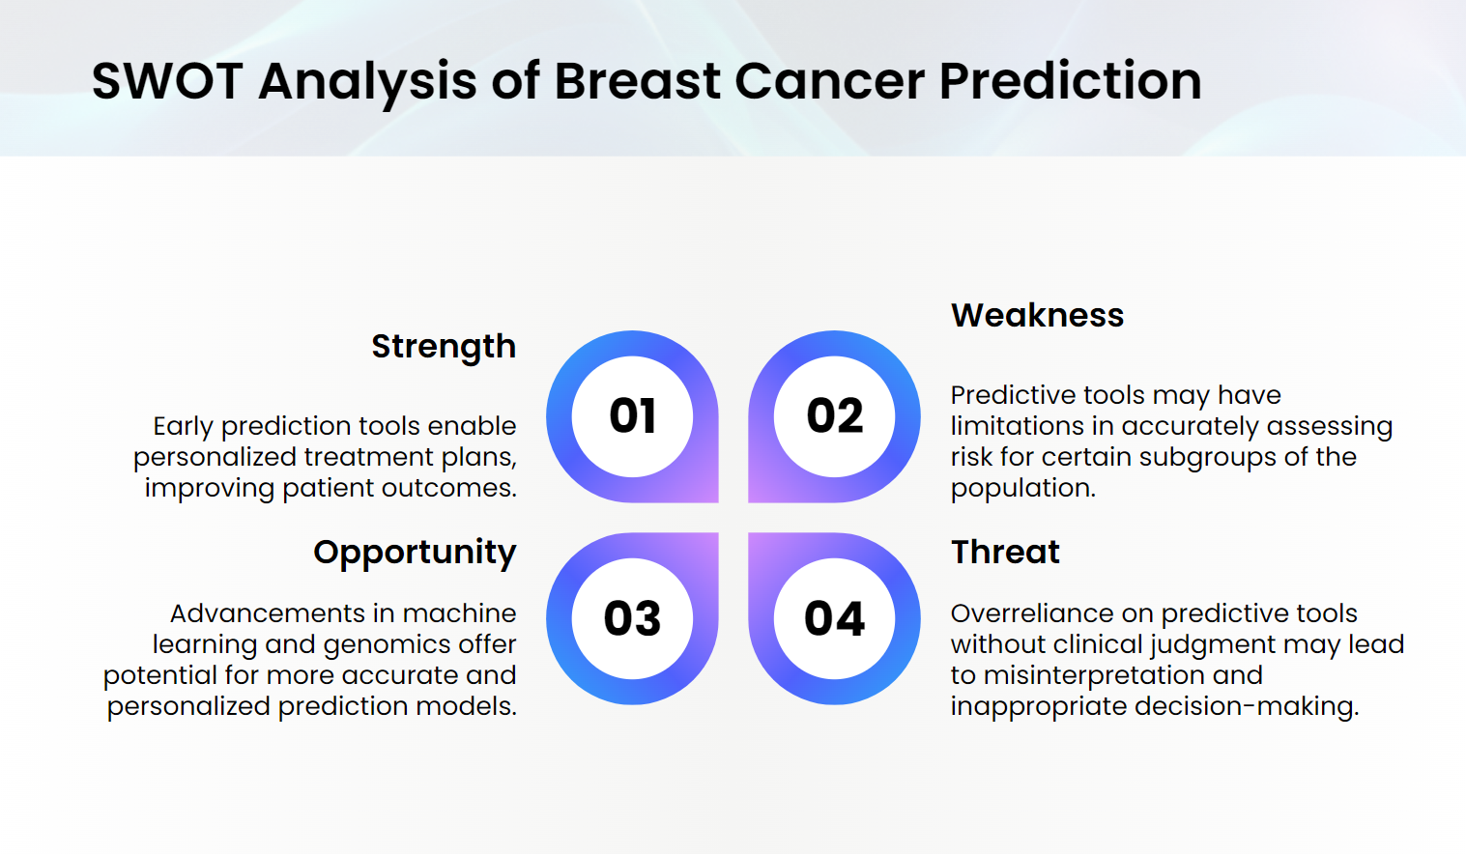
“This is a quote. Words full of wisdom that someone important said and can make the
reader get inspired.”
—Someone Famous

Slide 6
Mission
"Our mission is to pioneer advancements in breast cancer prediction through the application of logistic regression, utilizing cutting-edge data analytics to enhance early detection and risk assessment. Interpretable predictive model that empowers healthcare professionals and individuals alike in the fight against breast cancer."
Vision
"Our vision is a world where breast cancer is detected at its earliest stages, enabling more effective and less invasive treatments. Through the precision of logistic regression, we envision a healthcare landscape where predictive modeling becomes an integral component of routine breast cancer screening."

Slide 7
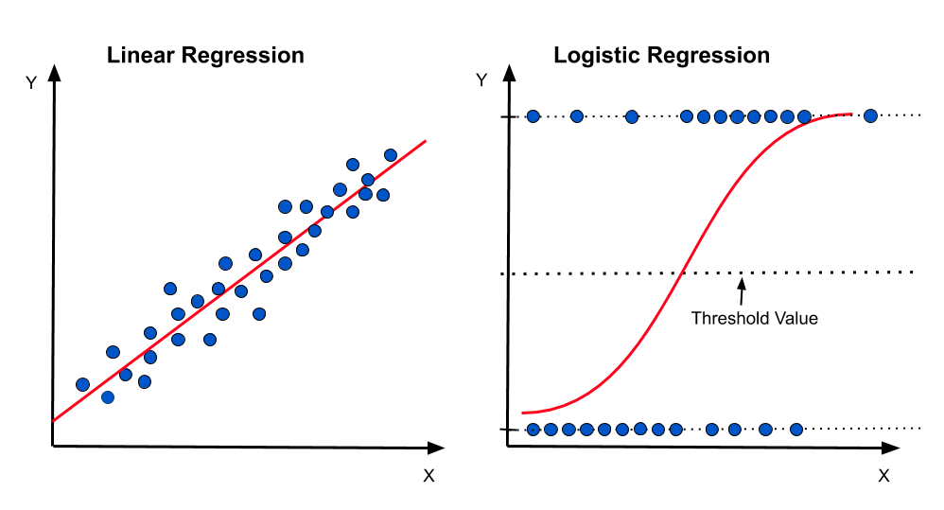
REGRESSION ANALYSIS
Regression Analysis is a Statistical method used to examine the
relationship between one dependent variable and One or More
independent variables.
Types of regression analysis:
LINEAR REGRESSION
LOGISTIC REGRESSION

Slide 8
Logistic
Regression:
Logistic regression is a statistical method commonly used in machine learning for binary classification problems, where the outcome variable is categorical with two possible classes.
In the context of breast cancer prediction or diagnosis, logistic regression can be employed to model the probability that a given set of features (independent variables) corresponds to either a malignant or benign tumor (two classes).

Slide 9
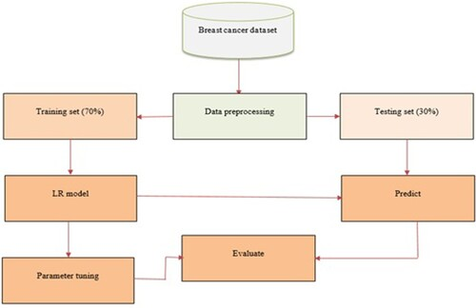
Here's how logistic regression might be applied in the context of breast cancer:
Data Collection
Data Preprocessing
Model Training
Model Evaluation
Feature Importance
Model Deployment

Slide 10
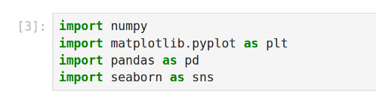
IMPORTING LIBRARIES
The required libraries are installed in your Python environment to facilitate data preprocessing, model development, and evaluation

Slide 11
LOADING THE DATA
The 'read_csv' function from the Pandas library is utilized to read the data from the CSV file. The resulting DataFrame, named 'df' , serves as the structured representation of the dataset. This step is fundamental for subsequent data manipulation, preprocessing, and exploration.

Slide 12
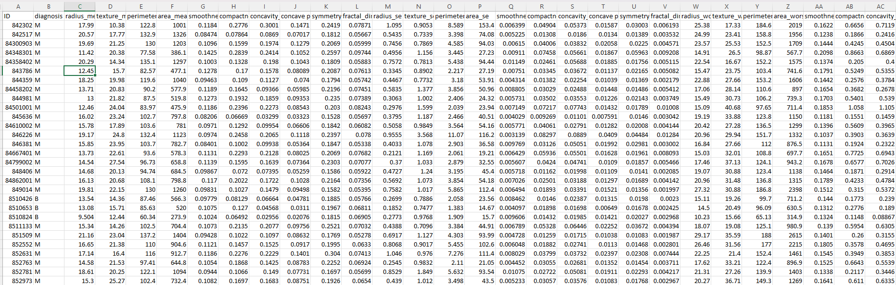
Take a view of Data

Slide 13

Data Set
The dataset records Breast Cancer cases in year 2020, with both male and female category.
It contains numerical and categorical input variables which are the result of a PCA transformation.
200
2014
2018

Slide 14
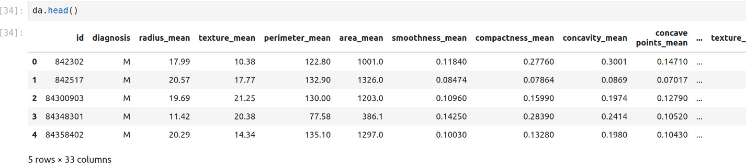
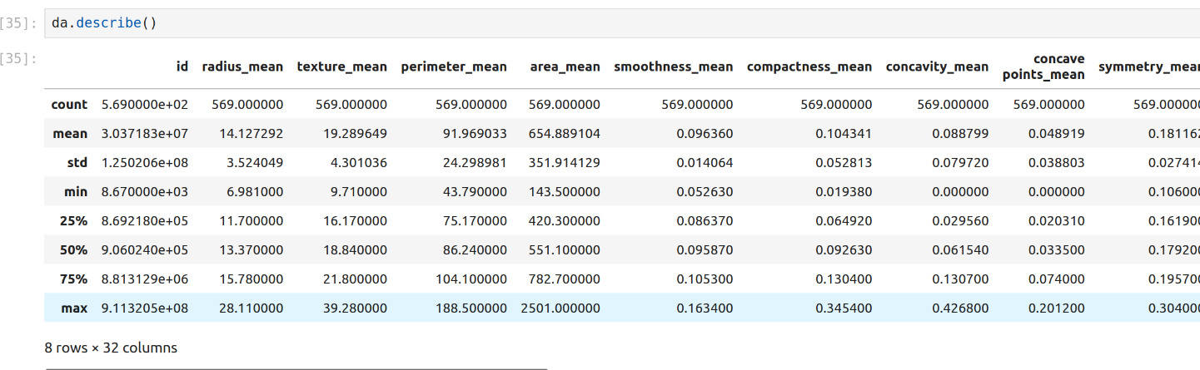
Data Visualization
The 'head()' function in Pandas shows the first five rows of a DataFrame, providing a quick over viewof the dataset's structure.
The 'describe()' function in Pandas summarizes statistical measures like count, mean, and percentiles for numerical Data Frame columns

Slide 15
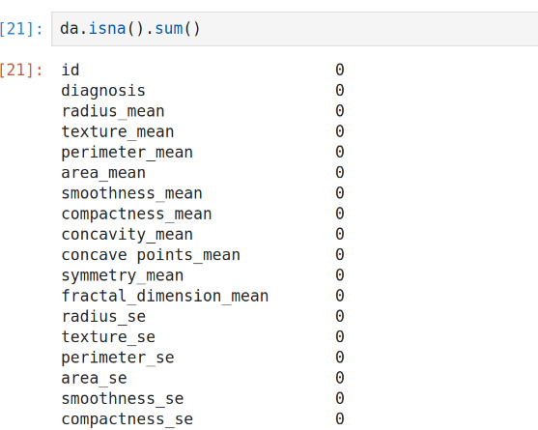
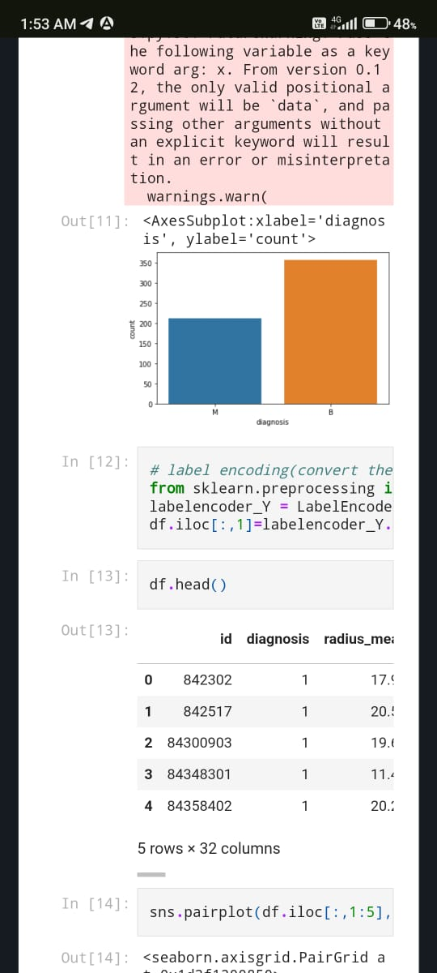


Attributes Information
Variants of Breast Cancer: Two types in graph:-
Malignant
Benign

Slide 16
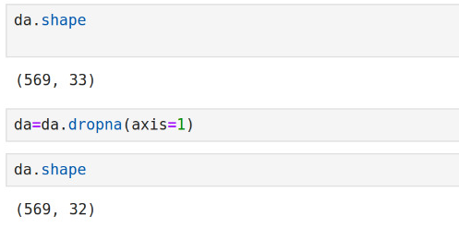
Deleting the Attribute
Deleting the Attribute by using the dropna( ).
Drop rows with any missing values [df_without_missing_values = df.dropna()]
Drop columns with any missing values [df_without_missing_values_columns = df.dropna(axis=1) ]

Slide 17
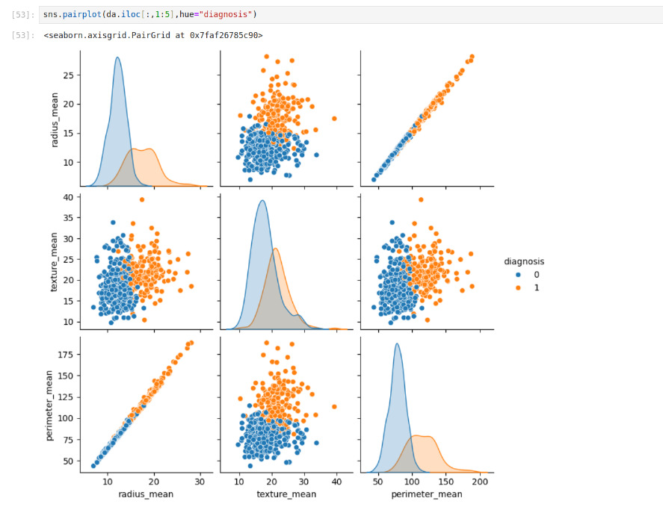
ANALYSIS
The Analysis is the overall diagnosis report and it shows relationships between multiple variables using scatter plots.
The "hue" parameter in the code specifies that the points in the scatter plots should be colored according to the value of the "diagnosis" variable.
The pairplot can be used to identify relationships between variables that may be useful for the task prediction.
The diagonal plots along the main diagonal of the pairplot show the distribution of each variable along itself.

Slide 18
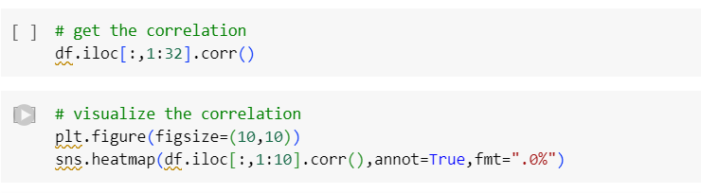
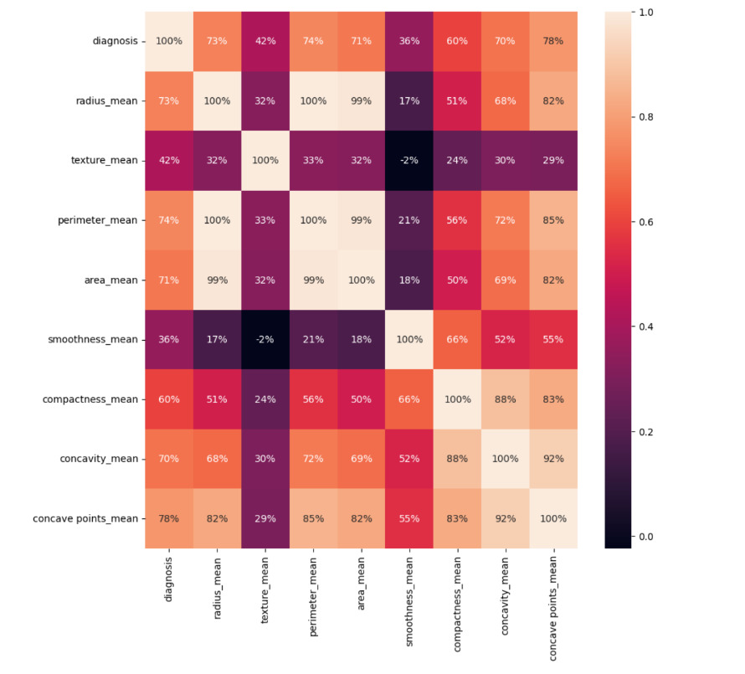
Correlation Analysis
Conducting a Pearson correlation analysis on Data Frame 'df' features, creating a correlation matrix (‘corr’), and visualizing results with a heatmap.

Slide 19
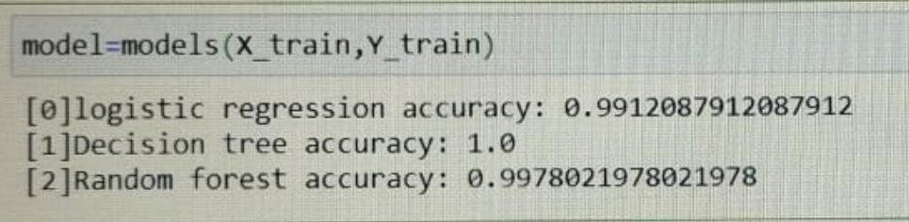
PREDICTION
This demonstrates the application of a trained Logistic Regression model to make predictions on the test dataset.
The Prediction Accuracy of the Data set is displayed below:

Slide 20
Goals and Objectives:
Early Detection: To develop a predictive model that can identify signs of breast cancer at an early stage.
Risk Assessment: To assess the risk of developing breast cancer for individuals based on relevant factors. Precision and Reliability: Develop a model that is precise and reliable in its predictions.
Enhance the trustworthiness of the model for both healthcare professionals and individuals. Interpretability: Ensure the interpretability of the predictive model for effective communication with healthcare professionals and patients

Slide 21
Conclusion
Our exploration into breast cancer prediction using logistic regression has yielded valuable insights into the potential of data analytics in the realm of healthcare. The application of logistic regression, with its ability to model the probability of breast cancer occurrence based on various contributing factors, has proven to be a robust and interpretable tool for early detection and risk assessment.

Slide 22
Thanks

Slide 23
Any Doubts…!?

